Slide 1
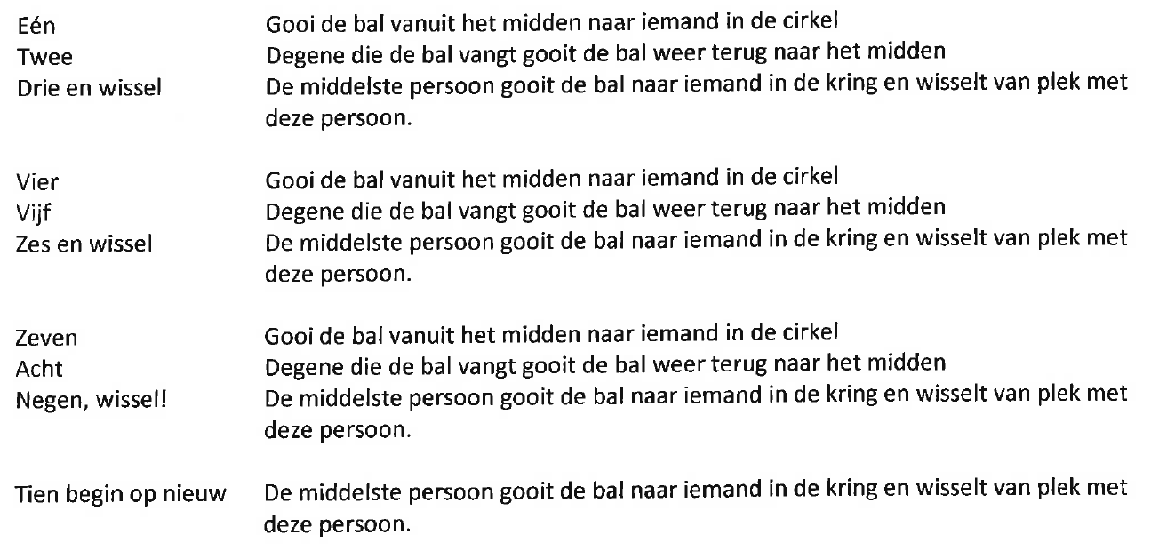
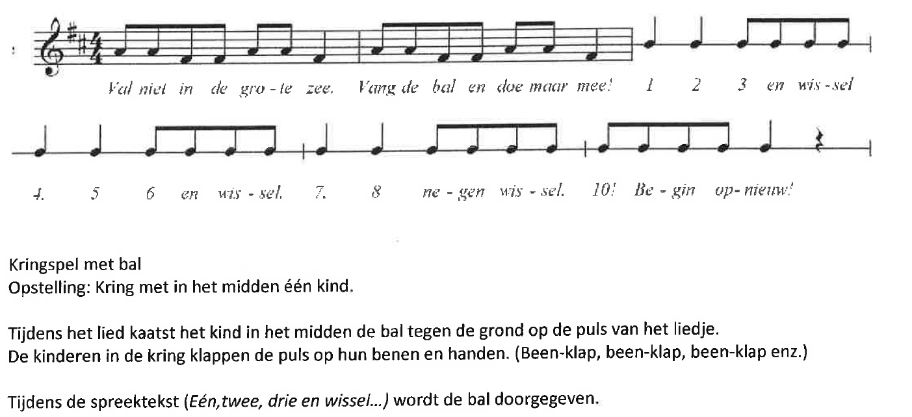
Val niet in de grote zee
I like coffee, I like tea
Will you catch the ball from me?
1, 2, 3 change places
4, 5, 6 change places
7, 8, 9 change places
10 and start again!

